Slide 1
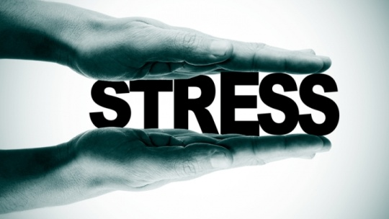
WEEK 1: INTRODUCTION & CONCEPTS
FEM3105

Slide 2
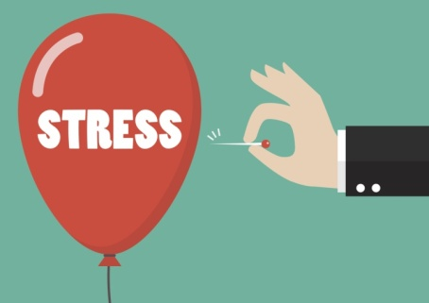
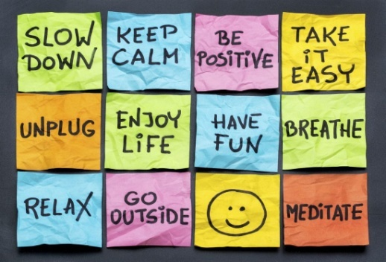
FEM 3105
STRESS & COPING 3(3+0)
WHY WE LEARN ABOUT STRESS AND COPING???
  WHY STRESS?
  WHY COPING?
  WHY STRESS AND COPING?

Slide 3



Understanding definition…
  STRESS
  COPING
  ADJUSTMENT

Slide 4

WHAT IS STRESS?
  According to Selyle (1956), STRESS is defined as the pressure experienced by a person in response to life demands.
  These demands are referred to as stressors and include a range of life events, physical factors (cold, hunger, haemorrhage, pain), environmental conditions and personal thoughts.
  STRESS is a feeling of emotional or physical tension. It can come from any event or thought that makes you feel frustrated, angry, or nervous. Stress is your body's reaction to a challenge or demand. In short bursts, stress can be positive, such as when it helps you avoid danger or meet a deadline.

Slide 5
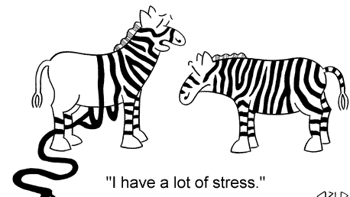
Categories of definitions of stress
  1. Self or bodily reactions to difficulties.
  2. Troublesome events.
  3. Perception of inability to overcome difficulties.
  4. A state of tension
  5. Others?

Slide 6
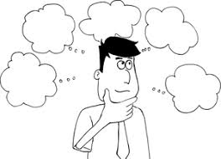
VARIOUS DEFINITIONS OF STRESS
(INDIVIDUALS)
A troubling situation, event or thought
(Anderson, 1978)
2. A troubling event
(Holmes, 1979)
A condition in which there is great discrepancy
between the demands made on an organism &
the organism’s capability to respond ( Caplan, 1981)

Slide 7
VARIOUS DEFINITIONS OF STRESS
Stress is how a person
appraises an event &
adapts to it.
(Folkman & Lazarus, 1984)
Any situation perceived as
threatening one’s well-being
& difficult to handle.
( Weiten & Lloyd, 1994)
A state of tension that is created when a person responds to the
demands & Pressures that come from work, family & other external
sources, as well as those that are generated from self imposed
demands, obligations & self criticism.
.
(http: //www.stressfree.com)

Slide 8
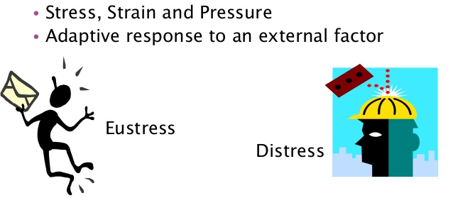
Aldwin (1994)
Quality of experience, produced through a person-environment transaction, that through over- or under-arousal, results in psychological or physiological distress
Hans Selye
The non-specific result of any demand upon the body, be the effect mental or somatic
Eustress is a positive stressful experience, a state of physical and psychological well-being that is associated with increased motivation and the acceptance of a challenge.
What is essential to well-being is a balance to produce an optimal level of arousal
Too little stress can be as harmful as too much
Stress can result from being over- or under-stimulated

Slide 9
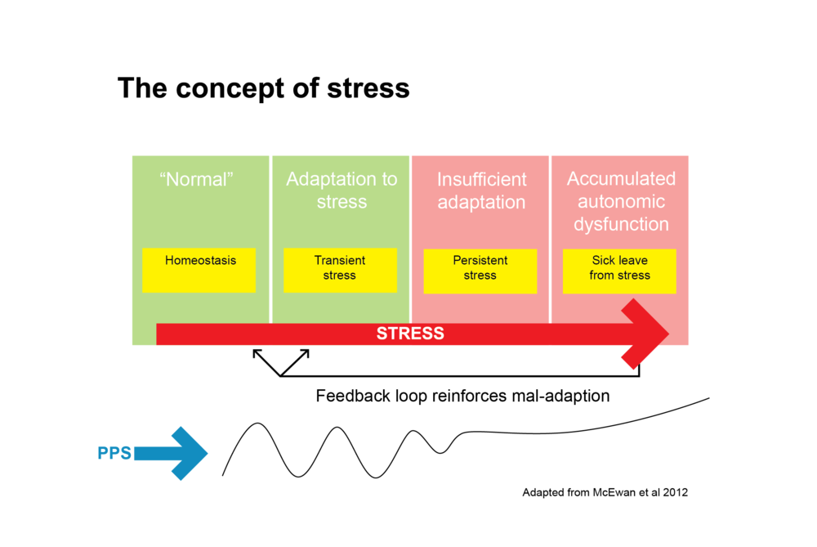
Lazarus & Folkman (1984)
A relationship between a person and the environment that is appraised by the person as taxing or exceeding his or her resources and endangering his/her well-being
This definition introduces the important notion of subjective appraisal
Walter Canon
Introduced the concept of homeostasis: body’s attempt at maintaining a stable internal state
Stress challenges homeostasis
Fight or Flight response
Complex ANS reaction in preparation for emergencies

Slide 10
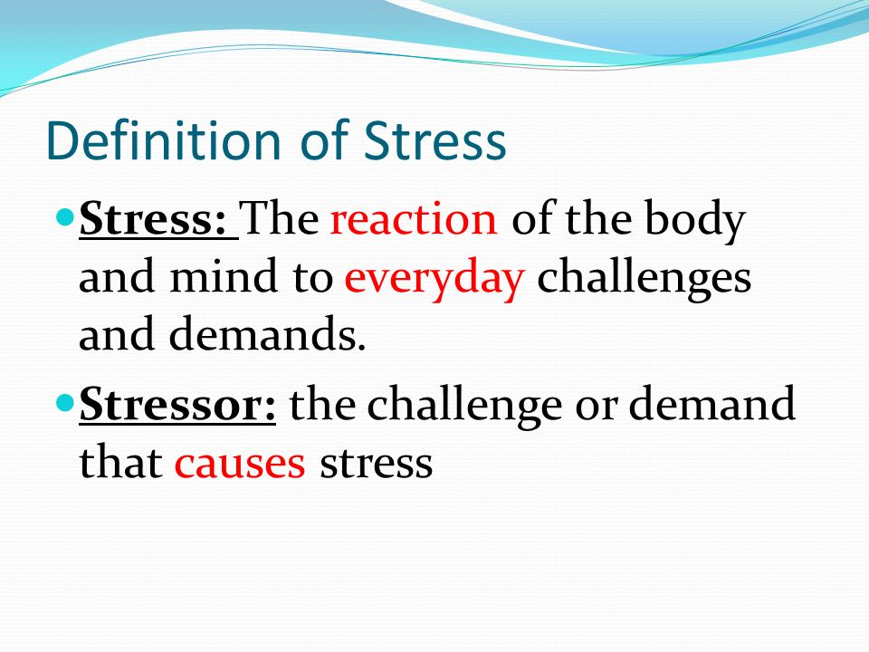
Rice, P. R. (1999)
Stressors
External, environmental demands placed on us that cause us to feel stressed
Subjective response
Interpretive mental state of the individual
Allows one to diminish, augment, or distort the impact of external events
Body’s physical response to stress
Physiological challenges which, if prolonged, can result in a negative state, or alternatively, an improved capacity to cope physiologically

Slide 11
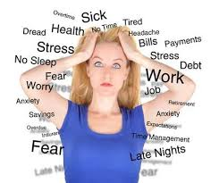
WHAT CAUSES STRESS ?
Life events such as divorce or separation, death of a loved one, the birth of a child, moving, a major financial setback, employment changes or becoming the victim of a crime or natural disaster.
Daily events such as traffic congestion, long commutes, working overtime, deadlines, personal conflicts, car trouble, job stress, and juggling household chores and childcare.
Environmental stressors such as pollution, weather extremes or excessive noise.
Physical stressors such as physical injury, chronic pain, tiring physical activity (such as traveling), and unsatisfied physical needs such as hunger, thirst or lack of sleep

Slide 12
Current Scenario…..?
MENTAL AND PHYSICAL HEALTH
80% of illnesses are psychosomatic i.e. illnesses which are mentally related.
Mental health problems can be addressed using various psychosocial measures such as stress reduction and cognitive modification.
INTER-RELATIONSHIP
Smoking – depression and anxiety (Patton et. Al., 1996)
Substance misuse – suicideal ideation, conduct disorder, ADD, PSTD, schizophrenia-like illneses (Hoven et. Al; Zeitlin, 1999)
Illicit drugs – violence, unwanted pregnancy, STD and adverse mental health (Sells & Blum, 1996)
MENTAL HEALTH FOUNDATION (2010)
Some form of mental health problem will affect one in four people in any one year
There have been substantial increases in identified psychosocial disorder of youth since WW2 in nearly all developed countries.

Slide 13
Blonna (2012): Four common ways to describe stress:
1. Stress as RESPONSE
Stress is something in the internal environment
Stress is defined as “the non-specific response of the body to any demand” (Hans Selye)
The non-specific response include symptoms such as increased muscle tension, breathing rate, hormonal release, metabolic rate etc
2. Stress as STIMULUS
Stress is something in the external environment
Stress is defined by the stimuli that one is exposed to (stress is bills, work, taxes etc.)
Some stimuli are defined as “life events” (Holmes & Rahe)

Slide 14
3. Stress as TRANSACTION
Stress is a transaction between a stimulus and a response (Lazarus & Folkman, 1987)
The transaction revolves around the appraisal of a “potential stressor” based on two questions:
  Is it a threat?
  Can I cope?
  Stimulus (potential stressor) and Personality (the individual) factors mediate the transaction
4. Stress as a HOLISTIC HEALTH PHENOMENON
Stress is a response that occurs when the dimensions of health (physical, social, spiritual, emotional, intellectual, occupational and environmental) are out of balance.
Lack of balance causes the body to make adjustments in order to regain and maintain homeostasis.

Slide 15
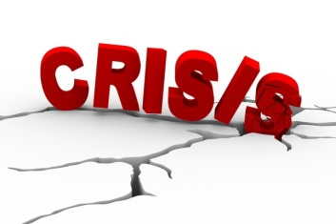
What is …
CRISIS?
Crisis is a situation that can not be resolved by usual method of coping mechanism; as a result a person becomes unable to function normally and requires intervention to regain equilibrium.
Crisis occurs when coping and defensive mechanism that has been used to solve problems and adapt to change is no longer effective.
A crisis is an acute, time-limited state of disequilibrium resulting from situational, developmental or social sources of stress.
A person in crisis is temporarily unable to cope with or adapt to the stressor by using methods of problem solving.
People in crisis generally have a distorted perception of the event and do not have adequate situational support or coping mechanisms.
Crises always involve change and loss.

Slide 16
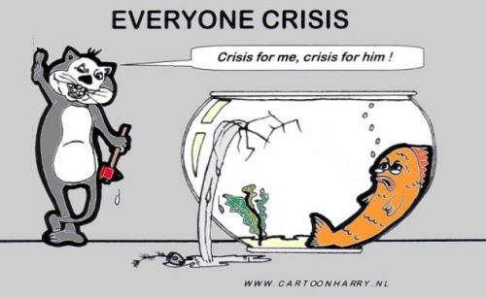
WHAT IS FAMILY CRISIS
Family crisis is the state where family functioning is completely disrupted or can no longer function normally… due to changes in the family structure (such as death, divorce, separation) or there are too many stressors at any one time.
As such family members experience very high levels of stress.
A threatening situation, or a situation where there are too many stressors, or a situation that cannot be handled (France, J, 1980)
Characteristics of crisis:
    Happens suddenly
    Inability to react
    Feelings of ‘hopelessness & ‘helplessness’ & fear
    Other stress symptoms

Slide 17
WHAT IS FAMILY STRESS
Family stress as an upset in the steady state of the family (Pauline Boss, 1987)
The family’s reaction to an event or stressor
Family stress is a state of tension brought about by the demand-capability imbalance in the family (McCubbin & McCubbin, 1989)

Slide 18
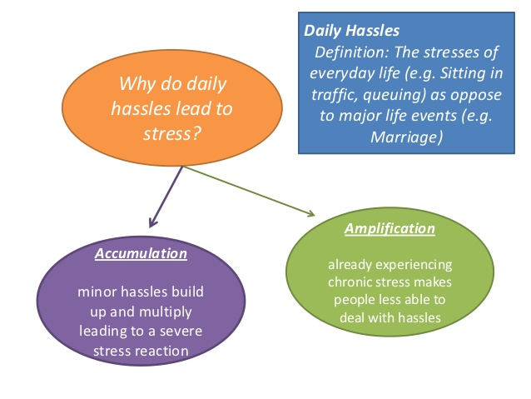
WHAT ARE ‘DAILY HASSLES’
(Lazarus & De Longis, 1988, Kanner 1981)
Relationship problems and irritating daily responsibilities.
‘Daily hassles’ considered as more stressful (Kanner et al., 1981, De Longis 1988).
More accurately predicts stress related diseases like flu, migraines, backaches etc.

Slide 19
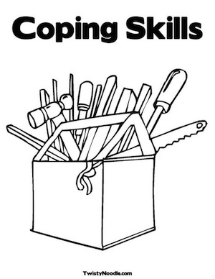
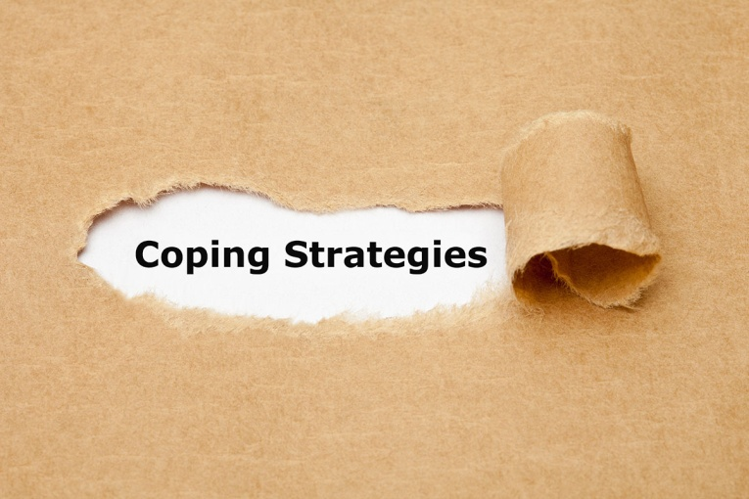
What is coping?

Slide 20
Coping…
In psychology, coping is the process of managing taxing circumstances, expending effort to solve personal and interpersonal problems, and seeking to master, minimize, reduce or tolerate stress or conflict (mostly intrapersonal).
COPING (Pearlin and Schooler,1978) :
as behavior that protects people from being psychologically harmed by problematic social experiences.
Coping serves a protective function that can be exercised in three ways:
  by eliminating or modifying stressful conditions;
  by perceptually controlling the meaning of the stressor; or
  by keeping emotional consequences in bounds.

Slide 21
COPING
(Lazarus, Averill and Opton, 1974):
"... the problem-solving efforts made by an individual when the demands he faces are highly relevant to his welfare (that is a situation of considerable jeopardy or promise), and when these demands tax his adaptive resources.“
(Lazarus and Launier, 1978, p. 311):
"Coping consists of efforts, both action oriented and intra psychic, to manage (i.e. master, tolerate, reduce, minimize) environmental and internal demands and conflicts.“
(Lazarus and Folkman, 1984):
"constantly changing cognitive and behavioral efforts to manage specific external and/or internal demands that are appraised as taxing or exceeding the resources of the person." (process oriented)
Coping allows people to use various skills to manage the difficulties they face in life.

Slide 22
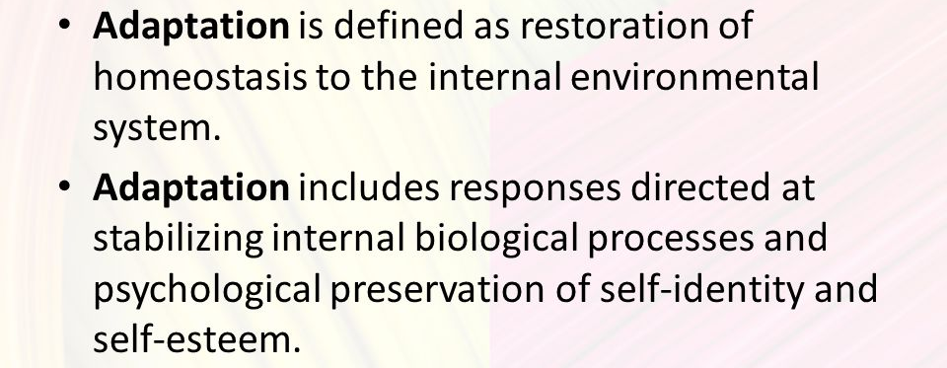
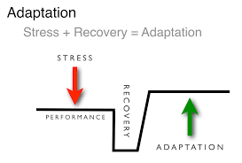
WHAT IS ADAPTATION?
Adaptation: is the change that takes place as a result of the response to a stressor.

Slide 23
CONCLUSION
Stress: is a condition in which the human system responds to changes in its normal balanced state.
Stressor: is any thing that is perceived as challenging, threatening or demanding.
Coping: various effort to manage stress
Adaptation: is the change that takes place as a result of the response to a stressor.
“I cannot, and should not, be cured of my stress but merely taught to enjoy it” (Hans Selye, l950)
Responses to stress are indispensable to our survival as they allow us to maintain the internal equilibrium necessary for optimal function

Slide 24
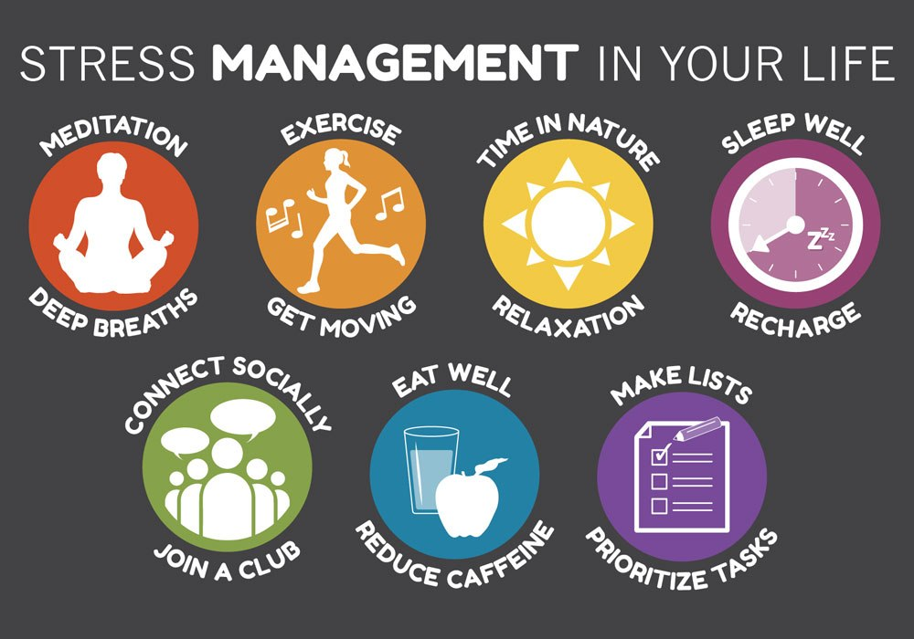
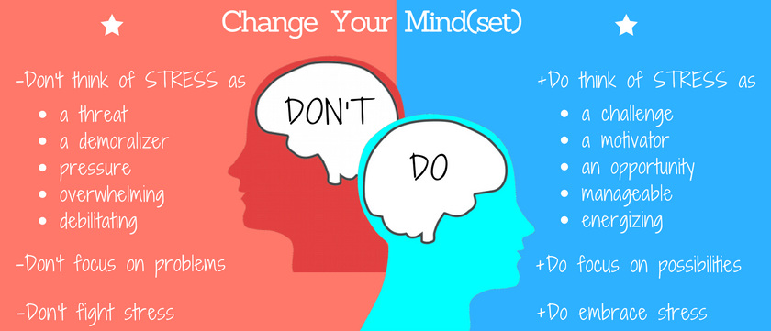

Slide 25
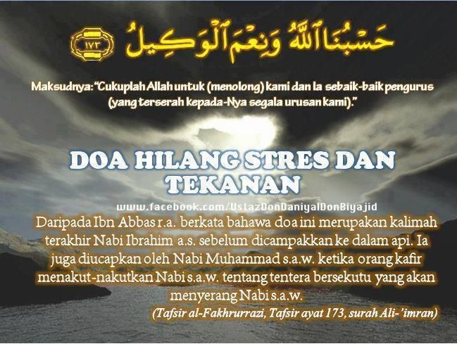
Comparative….Islamic Perspectives
Quranic Reflection on Stress Factors
"Be sure We will test you with something of fear and hunger, some loss in goods or lives, but give glad tidings to those who are steadfast, who say when afflicted with calamity: To God we belong and to Him is our return. They are those on whom (descend) blessings from God and mercy and they are the ones that receive guidance." (Quran 2:155)
Suggestion…for Muslim

Slide 26
THANK YOU

